Slide 1
Digital product design
Lecture 1: Introduction and Course Overview
Alex Moehring

Slide 2
Classroom Logistics
Participation:
Press and hold microphone for in class participants
Virtual participants raise your zoom hand
Chat will not be monitored

Slide 3
Attendance
Classroom has limited capacity and you have heterogeneous preferences
I will send a Brightspace survey asking your preferred modality
I have to give MBT students priority given this is a required course
I will randomly allocate remaining in-person seats to those wanting to attend in person
Goal is to allocate spots in classroom to those who prefer to attend in person

Slide 4
Outline
Motivation
What is different about digital products?
Overview of course, what course is and is not
Details of course
Introductions

Slide 5
Introduction to digital products

Slide 6
Something Has Changed in the Economy
Firm | Year Founded | Employees | Mkt Cap
BMW | 1916 | 116,000 | $53B
Uber | 2009 | 7,000 | $78B
Mariott | 1927 | 200,000 | $17B
AirBNB | 2008 | 5,000 | $31B
Walt Disney | 1923 | 185,000 | $260B
Facebook | 2004 | 12,691 | $783B

Slide 7

Something Has Changed in the Economy, Part 2

Slide 8
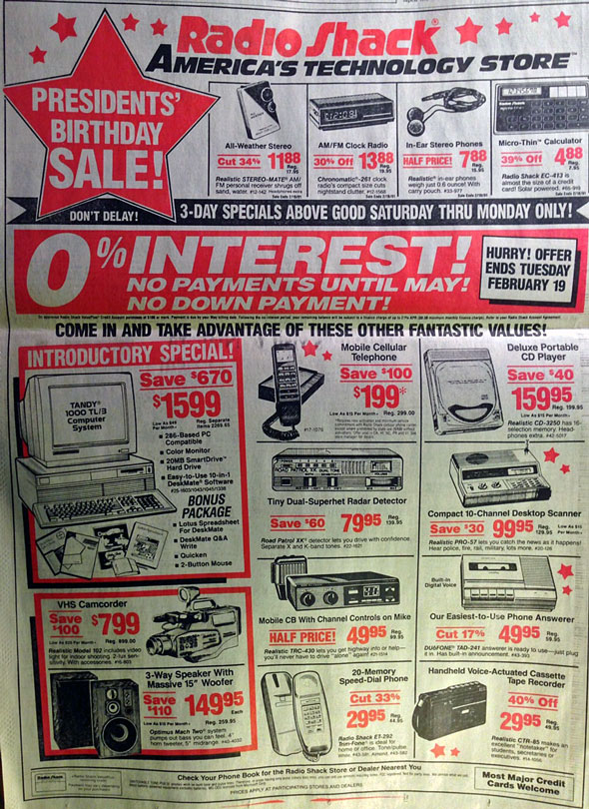
Something Has Changed in the Economy, Part 3

Slide 9
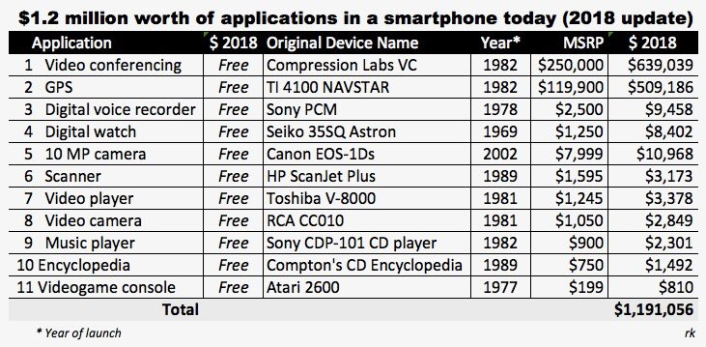
Something Has Changed in the Economy, Part 4
Source: @rakwong

Slide 10
What is Different When Goods Become Digital?
Physical goods: Atoms are costly to (re)produce
Digital goods: Bits are cheap to reproduce
Free, perfect, instant
Zero transportation costs
Implications
Costs shift to fixed rather than variable costs
Substantial economies of scale

Slide 11
What is Different When Goods Become Digital? Part 2
Vast data collected by user interactions with our product
How can we leverage this data to make better products?
Data are great, but need principled analysis to understand and extract insights
Expertise is often the constraint, not data

Slide 12
What is Different When Goods Become Digital? Part 3
“If you are looking for a career where your services will be in high demand, you should find something where you provide a scarce, complementary service to something that is getting ubiquitous and cheap. So what’s getting ubiquitous and cheap? Data. And what is complementary to data? Analysis.”
Hal Varian, Google Chief Economist
Question: What else is getting cheap? What is the scarce complement?

Slide 13
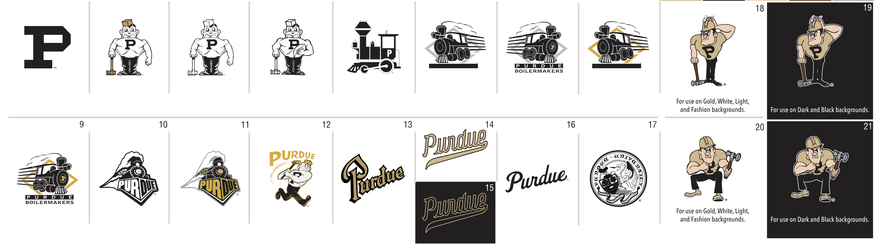
Digital Goods Are Easier to Modify / Reconfigure
Twenty Different Logos for Purdue
Question: How would you go about selecting the logo that sells best on a shirt in a physical store?
Question: How would you go about selecting the logo that sells best on a shirt in an online store?

Slide 14
Digital Goods Are Easy to Modify / Reconfigure
It is often easy to randomize what version of a digital good a user interacts with
This is an A/B test
We can then test empirically what version is best
Harder to do in an offline environment
In this class we will learn how to design and analyze A/B tests to improve our products

Slide 15
Course overview
* Ulrich & Eppinger Chapter 3

Slide 16
High-Level Overview
Digital products are fundamentally different from physical goods
But economic principles still apply
There is no magic formula to digital product design
If I could teach you how to generate and execute on a billion dollar idea, I would be a billionaire myself (I am not)
Focus instead on techniques to help you along in the process

Slide 17
What this Course is Not
A product management course
A lot of the techniques we discuss are relevant to PMs
DevOps is a nice complement to this course
A course on web design
Though we will learn how to evaluate our designs
A course about designing physical goods using digital tools
This is not a course on CAD

Slide 18
In this Course We Will Learn:
How to generate and assess new opportunities
How to identify customer needs and measure what consumers value
How to assess the competitive landscape and price our offering
Launch and go-to market strategies
How to assess the performance of our product
How to continually modify and improve the product
How to incorporate algorithms into digital products

Slide 19
Designing Algorithms
Algorithms play an increasingly large role in digital products
Recommendation systems, personalization, automated decision making, human-AI collaboration, …
The last few lectures will be devoted to frameworks to design algorithms in digital products
This will emphasize recent research on the topics as we actively try to understand such new tools

Slide 20
Course Structure
* Ulrich & Eppinger Chapter 3

Slide 21
Course Format
Lectures: Tu/Th 4:30-5:45pm
Participation is important
You all have unique experiences to share & contribute
There are optional readings in the syllabus, class should be self-contained
Ulrich and Eppinger. Product Design and Development
Kohavi, Tang, and Xu. Trustworthy Online Controlled Experiments

Slide 22
Grading
Participation (10%)
Come to class and contribute positively, hopefully everyone gets full credit here
Key is to not participate negatively

Slide 23
Grading, Part 2
Individual assignments (40%)
Three individual assignments intended on reinforcing the concepts we learn in class. These will be empirical but can be done without any programming

Slide 24
Team Project (50%)
Create a proposal for a digital product with a team of 4
Apply the concepts we learned in the class to improve the proposal
Example:
Apply survey techniques to learn what users value, set a price
Run an A/B test to refine a prototype
Do an analysis to refine the metrics you use to measure performance
…

Slide 25
Team Project (50%), Continued
Best projects come from things you care about
Business / community org / club you are involved in
Can also be hypothetical (i.e. a new product)
Key Dates
10/31: Team formed and product selected (email me your team)
11/6: Midpoint check-ins
12/9-12/11: Final project presentations + final report due

Slide 26
Introductions: about me

Slide 27
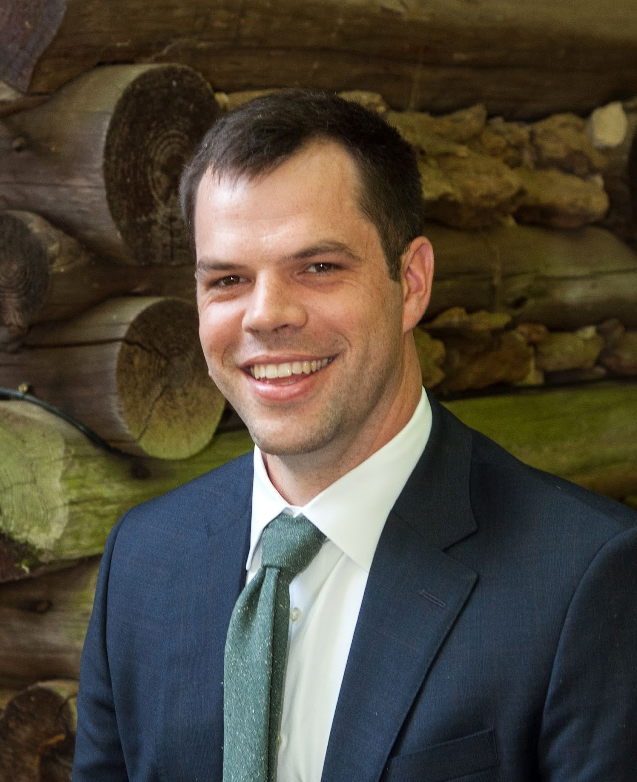
Alex Moehring
Undergrad at UNC Chapel Hill
Industry Experience: Wells Fargo Securities
Microsoft Research
PhD at MIT Sloan
Assistant Professor at Purdue Daniels

Slide 28
My Research
Ranking algorithms on social media
Human-AI collaboration
Social influence
All papers available at www.alexmoehring.com

Slide 29
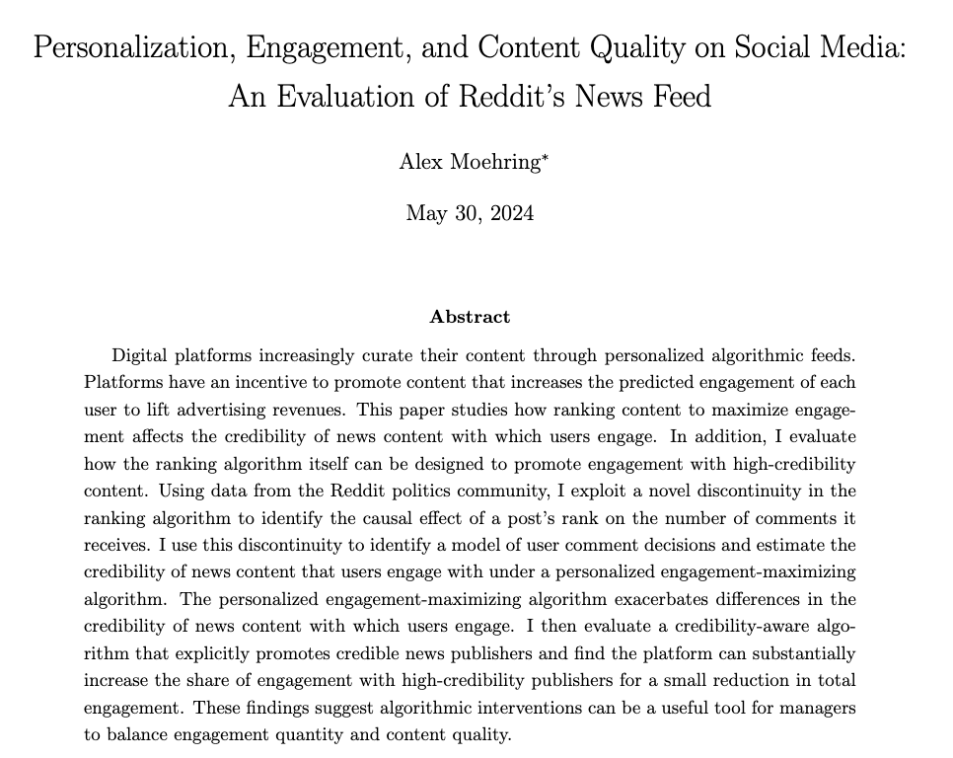
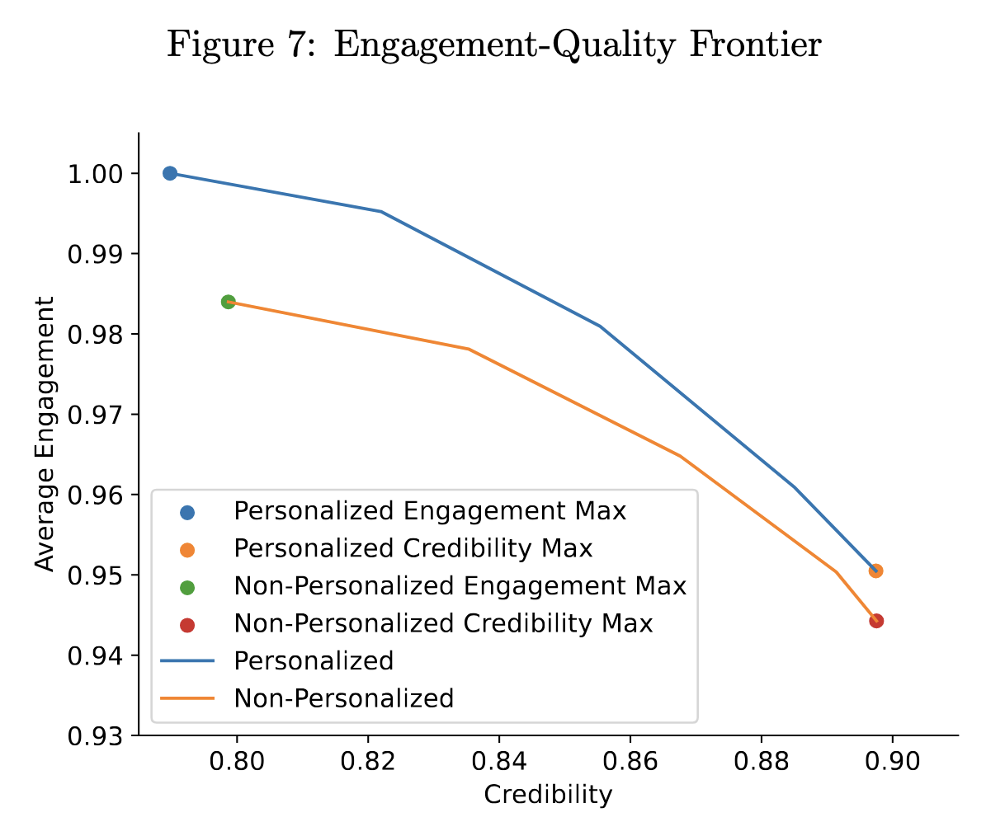
Ranking Algorithms on Social Media
$$d_{ijt}=1\left[v_{ijt}=1\right]1[u_{ijt}≥u_{i0t}]$$

Slide 30
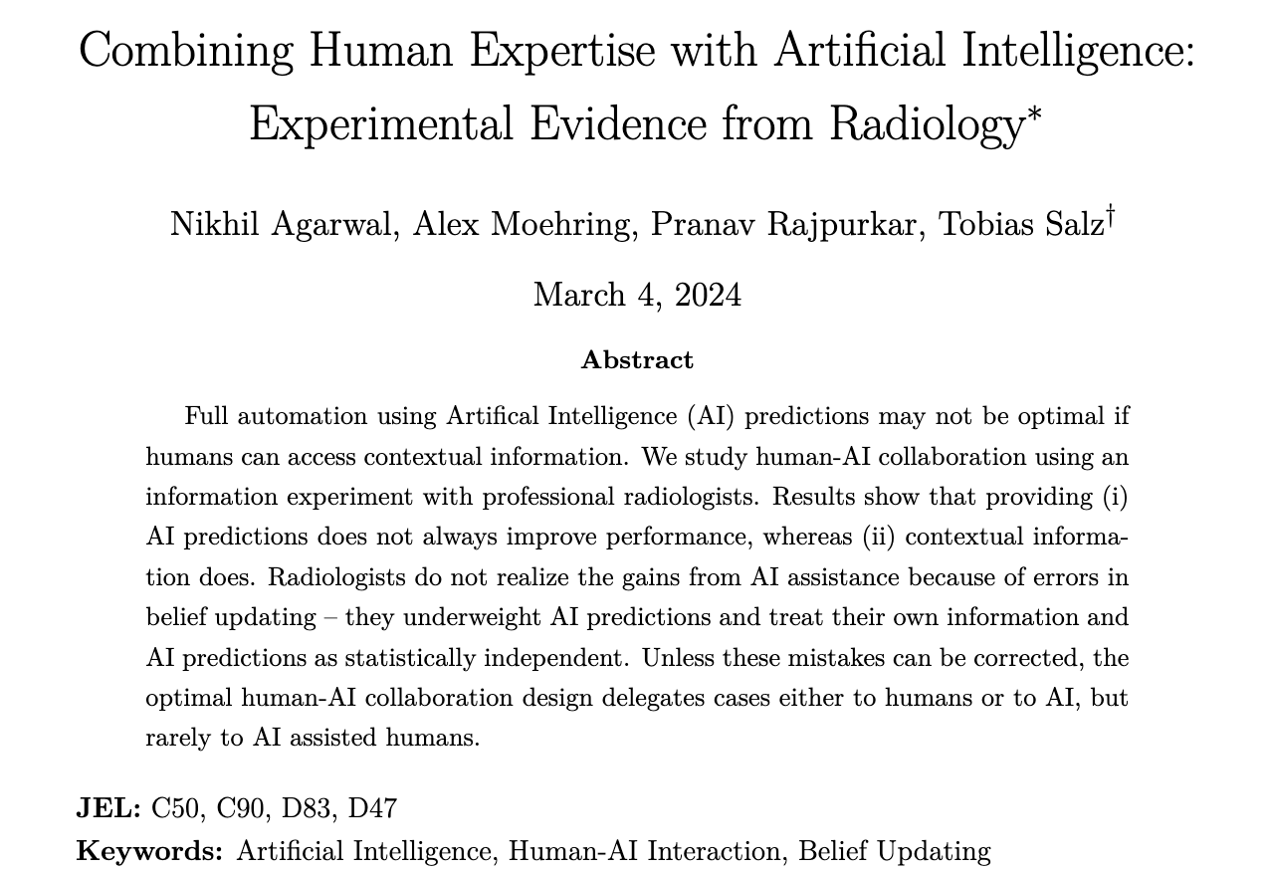
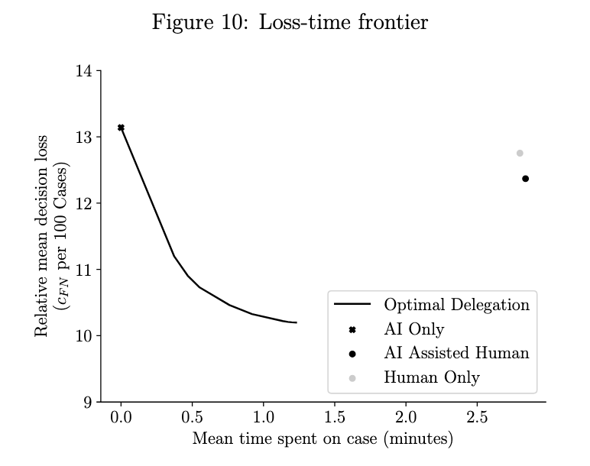
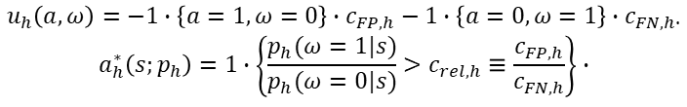
Human-AI Collaboration
$$u_{h}\left(a,ω\right)=−1∙\left\{a=1,ω=0\right\}∙c_{FP,h}−1∙\left\{a=0,ω=1\right\}∙c_{FN,h∙}$$
$$a_{h}^{∗}\left(s;p_{h}\right)=1∙\left\{\frac{p_{h}(ω=1|s)}{p_{h}(ω=0|s)}>c_{rel,h}≡\frac{c_{FP,h}}{c_{FN,h}}\right\}∙$$

Slide 31
Additional Work
Social influence online
How do social norms influence health behaviors
How do social image concerns impact online behaviors
Ongoing work: Human-AI collaboration
How to design human-AI collaboration accounting for endogenous human responses

Slide 32
Office Hours + Contacting Me
My office is Kran 540
Office hours Tuesdays 6-7pm or by appointment
Happy to discuss course content, advanced topics, applications, research, …
Email guidelines (moehring@purdue.edu)
MGMT 682: [[Informative summary]]
Follow–up if I don’t respond within 1 business day

Slide 33
Introductions: About you

Slide 34
Introductions
Name
Program
Why you took the course / what you hope to learn
What industry you worked in previously or hope to work in after Purdue
Project pitches: If you have a product you’d like to study in your project, make a pitch to classmates to join you!

Slide 35
Questions

Slide 36
Next Time
Ideation & Opportunity Development

